Slide 1
Running Mixed Workloads on Kubernetes at IHME
Dr Tyrone Grandison, IHME
Jason Smith, Univa

Slide 2


Your Speakers
Tyrone Grandison
Chief Information Officer, IHME
Jason Smith
Principal Solutions Architect, Navops

Slide 3
Flow
Introducing the Institute for Health Metrics and Evaluation (IHME)
Introducing Univa
The IHME Environment
Univa and IHME
Notes:
First two sections are intros to company
End with solution for IHME
IHME Env will be Ty
Then Benefits

Slide 4
Introducing the Institute for Health Metrics and Evaluation (IHME)

Slide 5
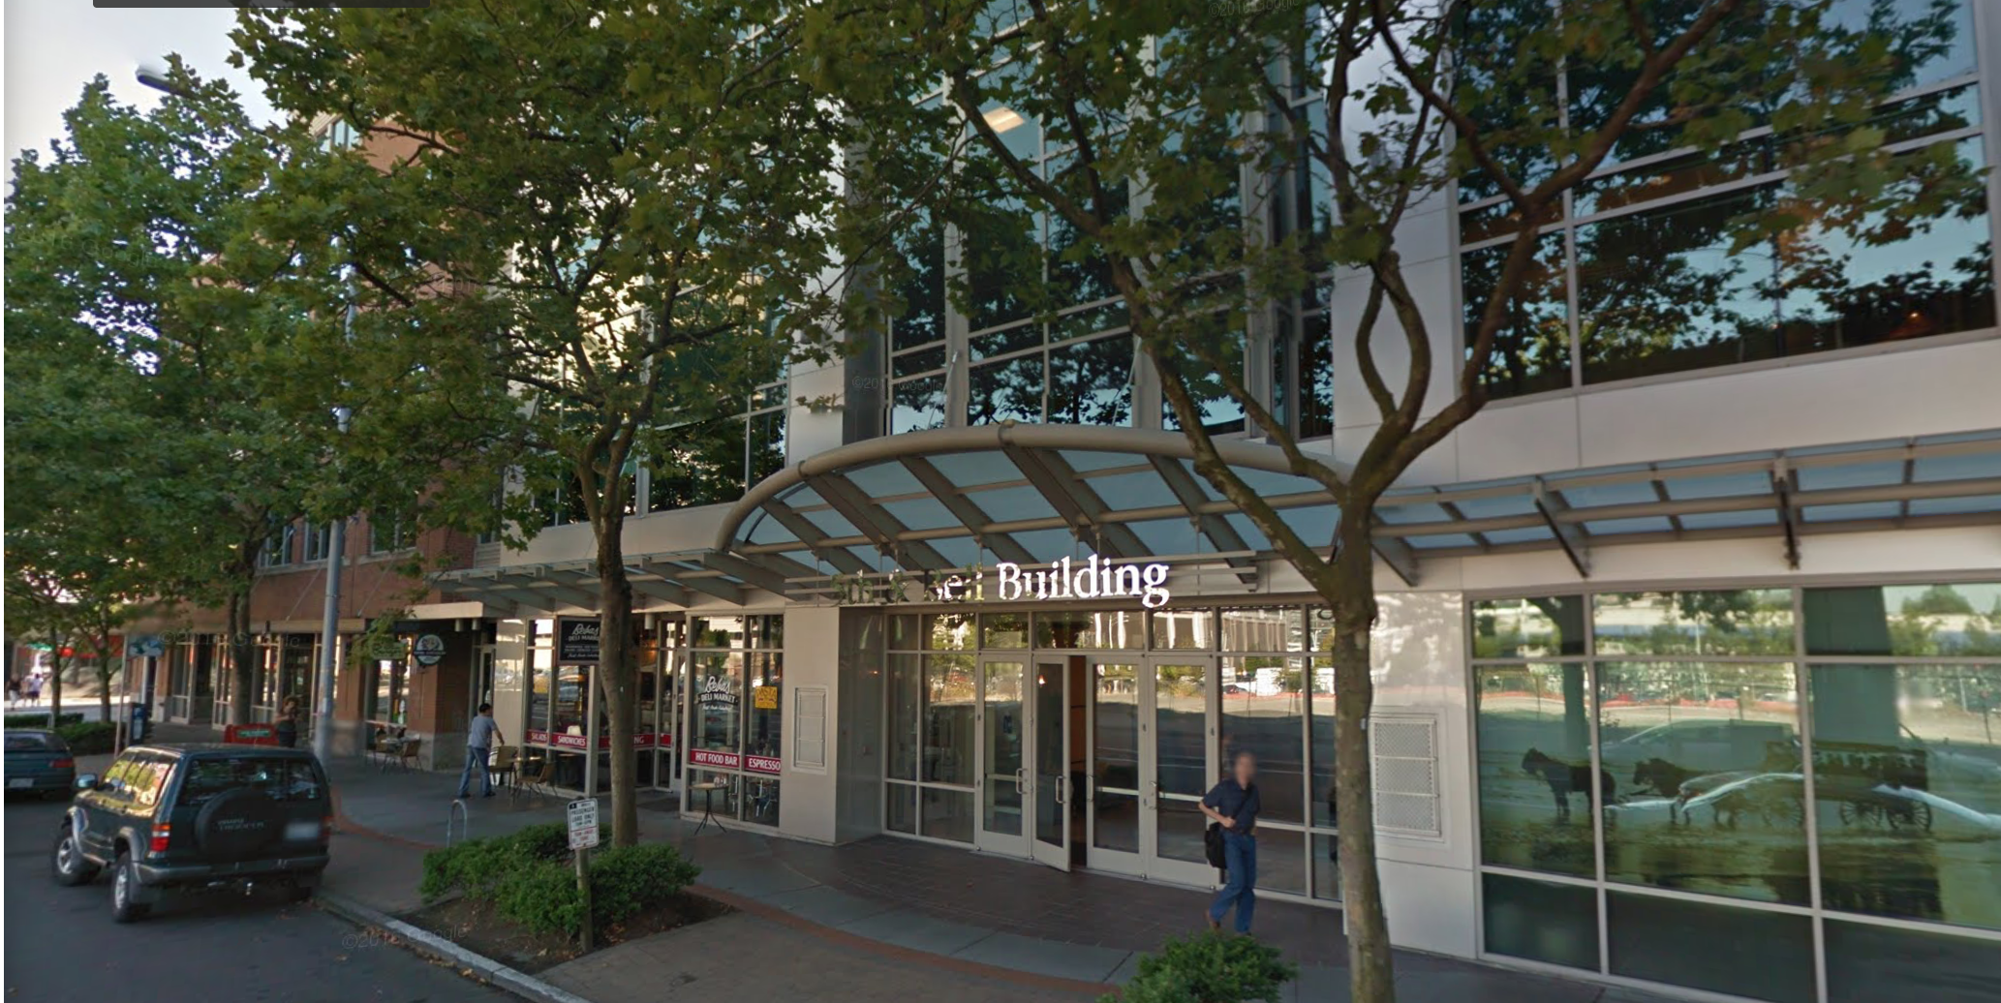
Institute for Health Metrics and Evaluation
Identity: UW-affiliated, population health-focused research institute.
Mission: improve the health of the world by
collecting synthesizing providing
the world’s best population health data.
Product: high-quality population health data.
Other Products: training, visualizations, special analyses.
Customers: researchers, advocates, policy makers, media, academics.

Slide 6
IHME Process

Slide 7
High-Quality Population Health Data
Global Burden of Disease: a systematic, scientific effort to quantify the comparative magnitude of health loss due to diseases, injuries, and risk factors by age, sex, and geography over time.
Global Health Data Exchange: the world’s most comprehensive catalog of public health data sources.
Geospatial Analysis: measure all components of the GBD from 1990 to present at the 1 km X 1 km level.
Forecasting, Scenarios, and Cost-Effectiveness: Develop probabilistic baseline forecasts of population health, including microsimulations exploring a broad range of what-if scenarios.
Special analyses: geographic- or subject-specific projects.

Slide 8

Example: Global Burden of Disease 2016
335 diseases and injuries
1,974 sequelae of disease
84 risk factors of disease
2,613 cause-risk pairs
269 covariates
323 locations
23 age groups
3 sexes
26 years
36 measures
3 metrics
Billions of points of data
More than 30.3 TB of data
More than 3,000 points of metadata
More than 150,000 data sources

Slide 9
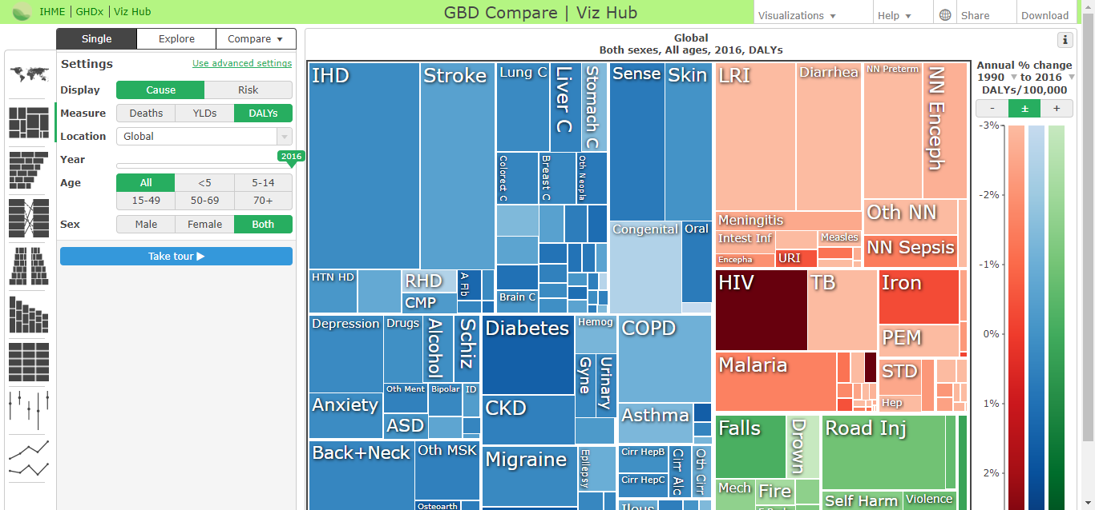
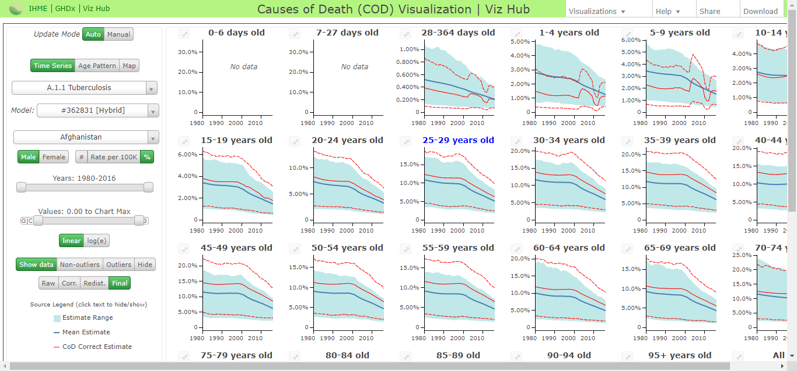
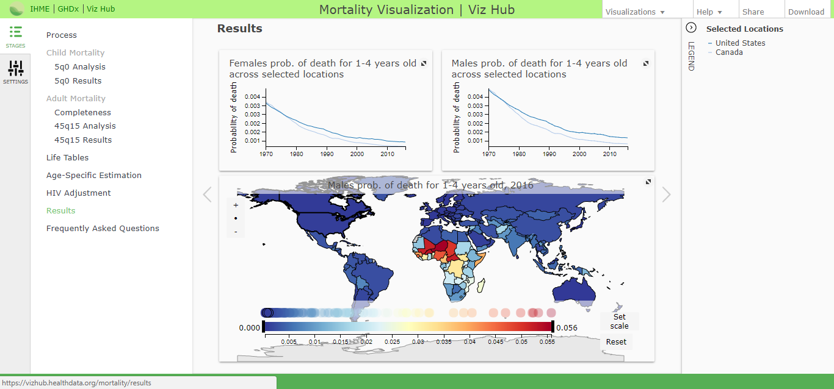
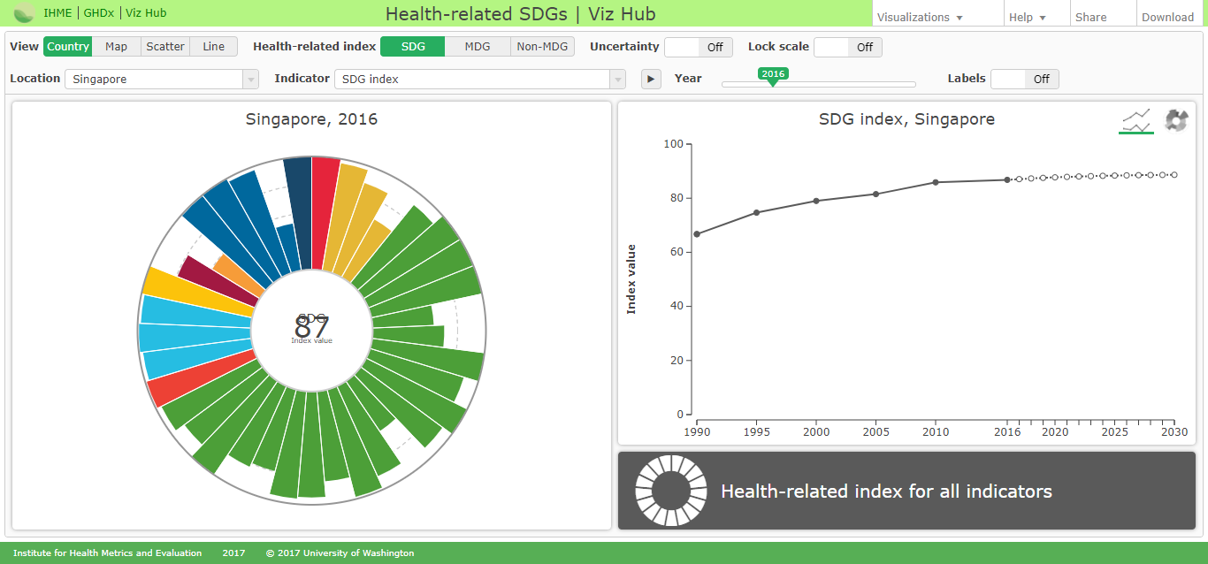
Example: Global Burden of Disease 2016
GBD Publications
GBD Reports
GBD Visualizations and Tools
Mortality Visualization
Causes of Death Visualization
Epi Visualization
GBD Compare
GBD Data Input Sources Tool
GBD Results Tool

Slide 10

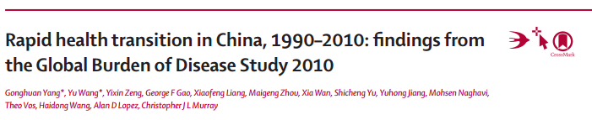
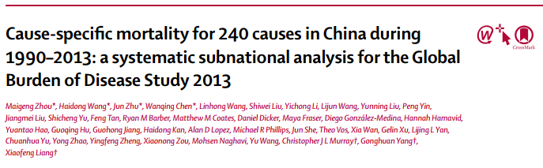
Impacts of Data – Policy
Collaborators: World Bank, WHO, MDG Health Alliance, etc.
Governments: UK, Mexico, China, Saudi Arabia, Indonesia, Norway, Georgia, India, Rwanda, etc.
Examples:
Public Health England
China GBD Collaborative Research Center
State-level India disease burden
Data requests daily from more than 72 countries

Slide 11
Introducing Univa

Slide 12
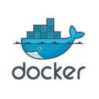




Who is Univa?
Univa is the leading innovator of workload orchestration and container optimization solutions
Global reach – based in Chicago with offices in Canada and Germany
Fast growing enterprise software company
Support some of the largest clusters in global Fortune 500 companies

Slide 13





























Univa Customers
Data Services | Energy | Gov’t | Financial | Life Sciences | Manufacturing / Technology

Slide 14
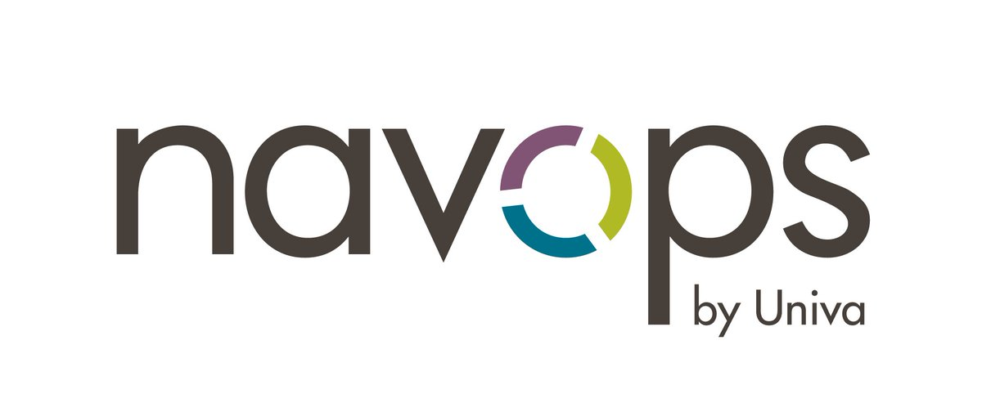
Navops for Kubernetes
Virtual Multi-tenancy
Mixed Workloads
Manage Cloud Resources
Application Workflows
Run Mesos Frameworks
Share clusters across teams and applications
Run containerized and non-containerized workloads on shared resources
Prioritize workloads to efficiently use on-premises and cloud resources
Sequence workflows to address job dependencies
Run frameworks seamlessly on a Kubernetes cluster

Slide 15
The IHME Environment

Slide 16
IHME Technology Team
Mission:
To enable, empower and engage our partners in improving public health globally through data and innovative technologies.​
Details:
Sixty-one People across
Infrastructure/DevOps, Data Management, Visualization, Data Science, Engineering, Workforce Technology Enablement.

Slide 17
IHME Technology Users
Researchers
Differing technology backgrounds
Need to run sophisticated statistical models
Need to have customized tech stack
IHME Support Functions (Finance & Planning Operations, Human Resources & Training, Global Engagement, Executive Support Team)
Document Management
Collaboration Management
Customer Relationship Management
Notes:
Day-to-day support

Slide 18

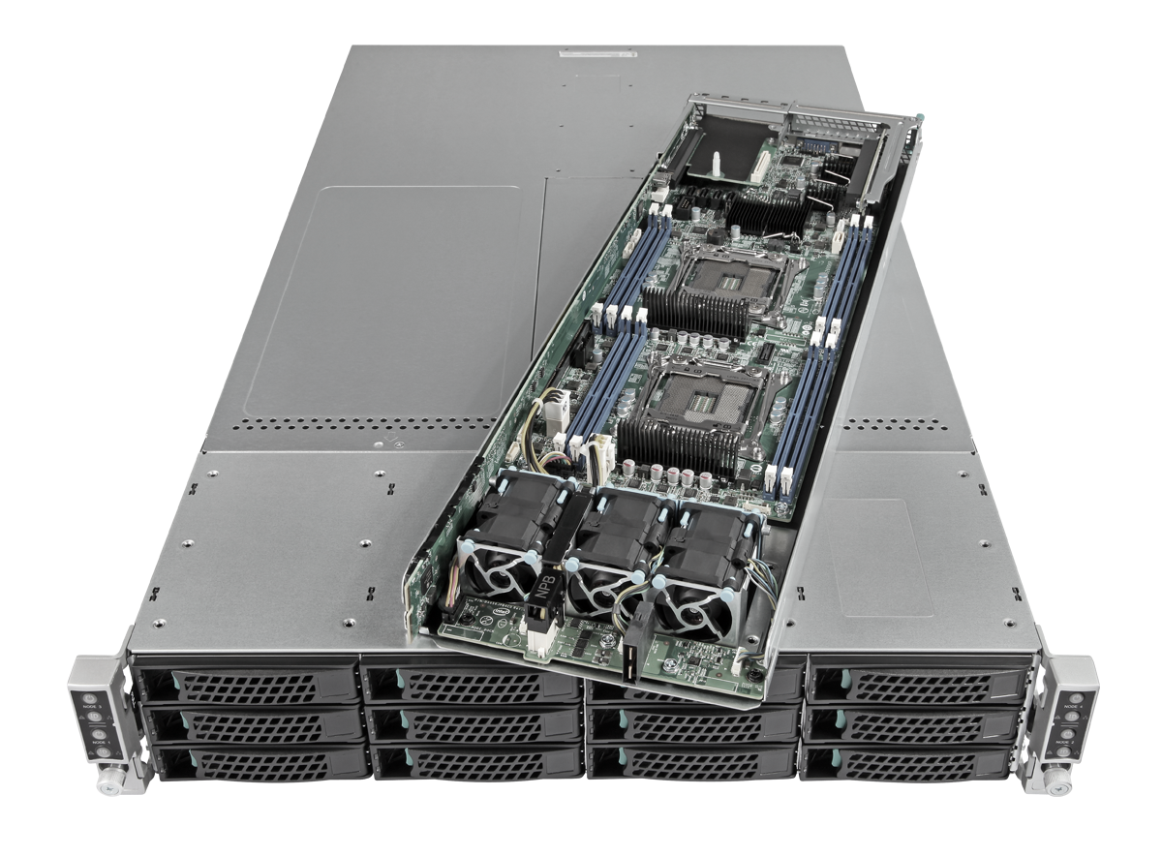
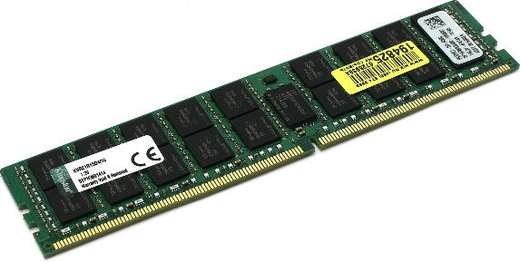
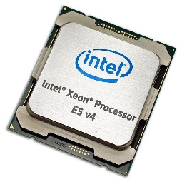
Environment Overview
HPC nodes: 550
Intel and AMD
dev and prod
Virtual machines: 381
VMware vSphere
Containers: 300
Docker
Usable Storage: 5.8 PB
Qumulo clusters
Tape Storage: 9.2 PB
An Intel HPC Node
56 compute cores
512 GB of memory
800 GB of solid state storage

Slide 19


Hardware
HPC Cluster
Primary Modeling:
500x Heterogeneous x86 nodes for ~25k cores, 150TB Memory
Machine Learning:
4x Nvidia CUDA on Kepler
Storage Tiers
Primary ingress & archival (StornextFS)
VMWare for public facing DB & Web (LSI & Netapp Arrays)
HPC transform & scratch (Qumulo)
Fabrics
10/40G Ethernet
Infiniband & Fiberchannel

Slide 20
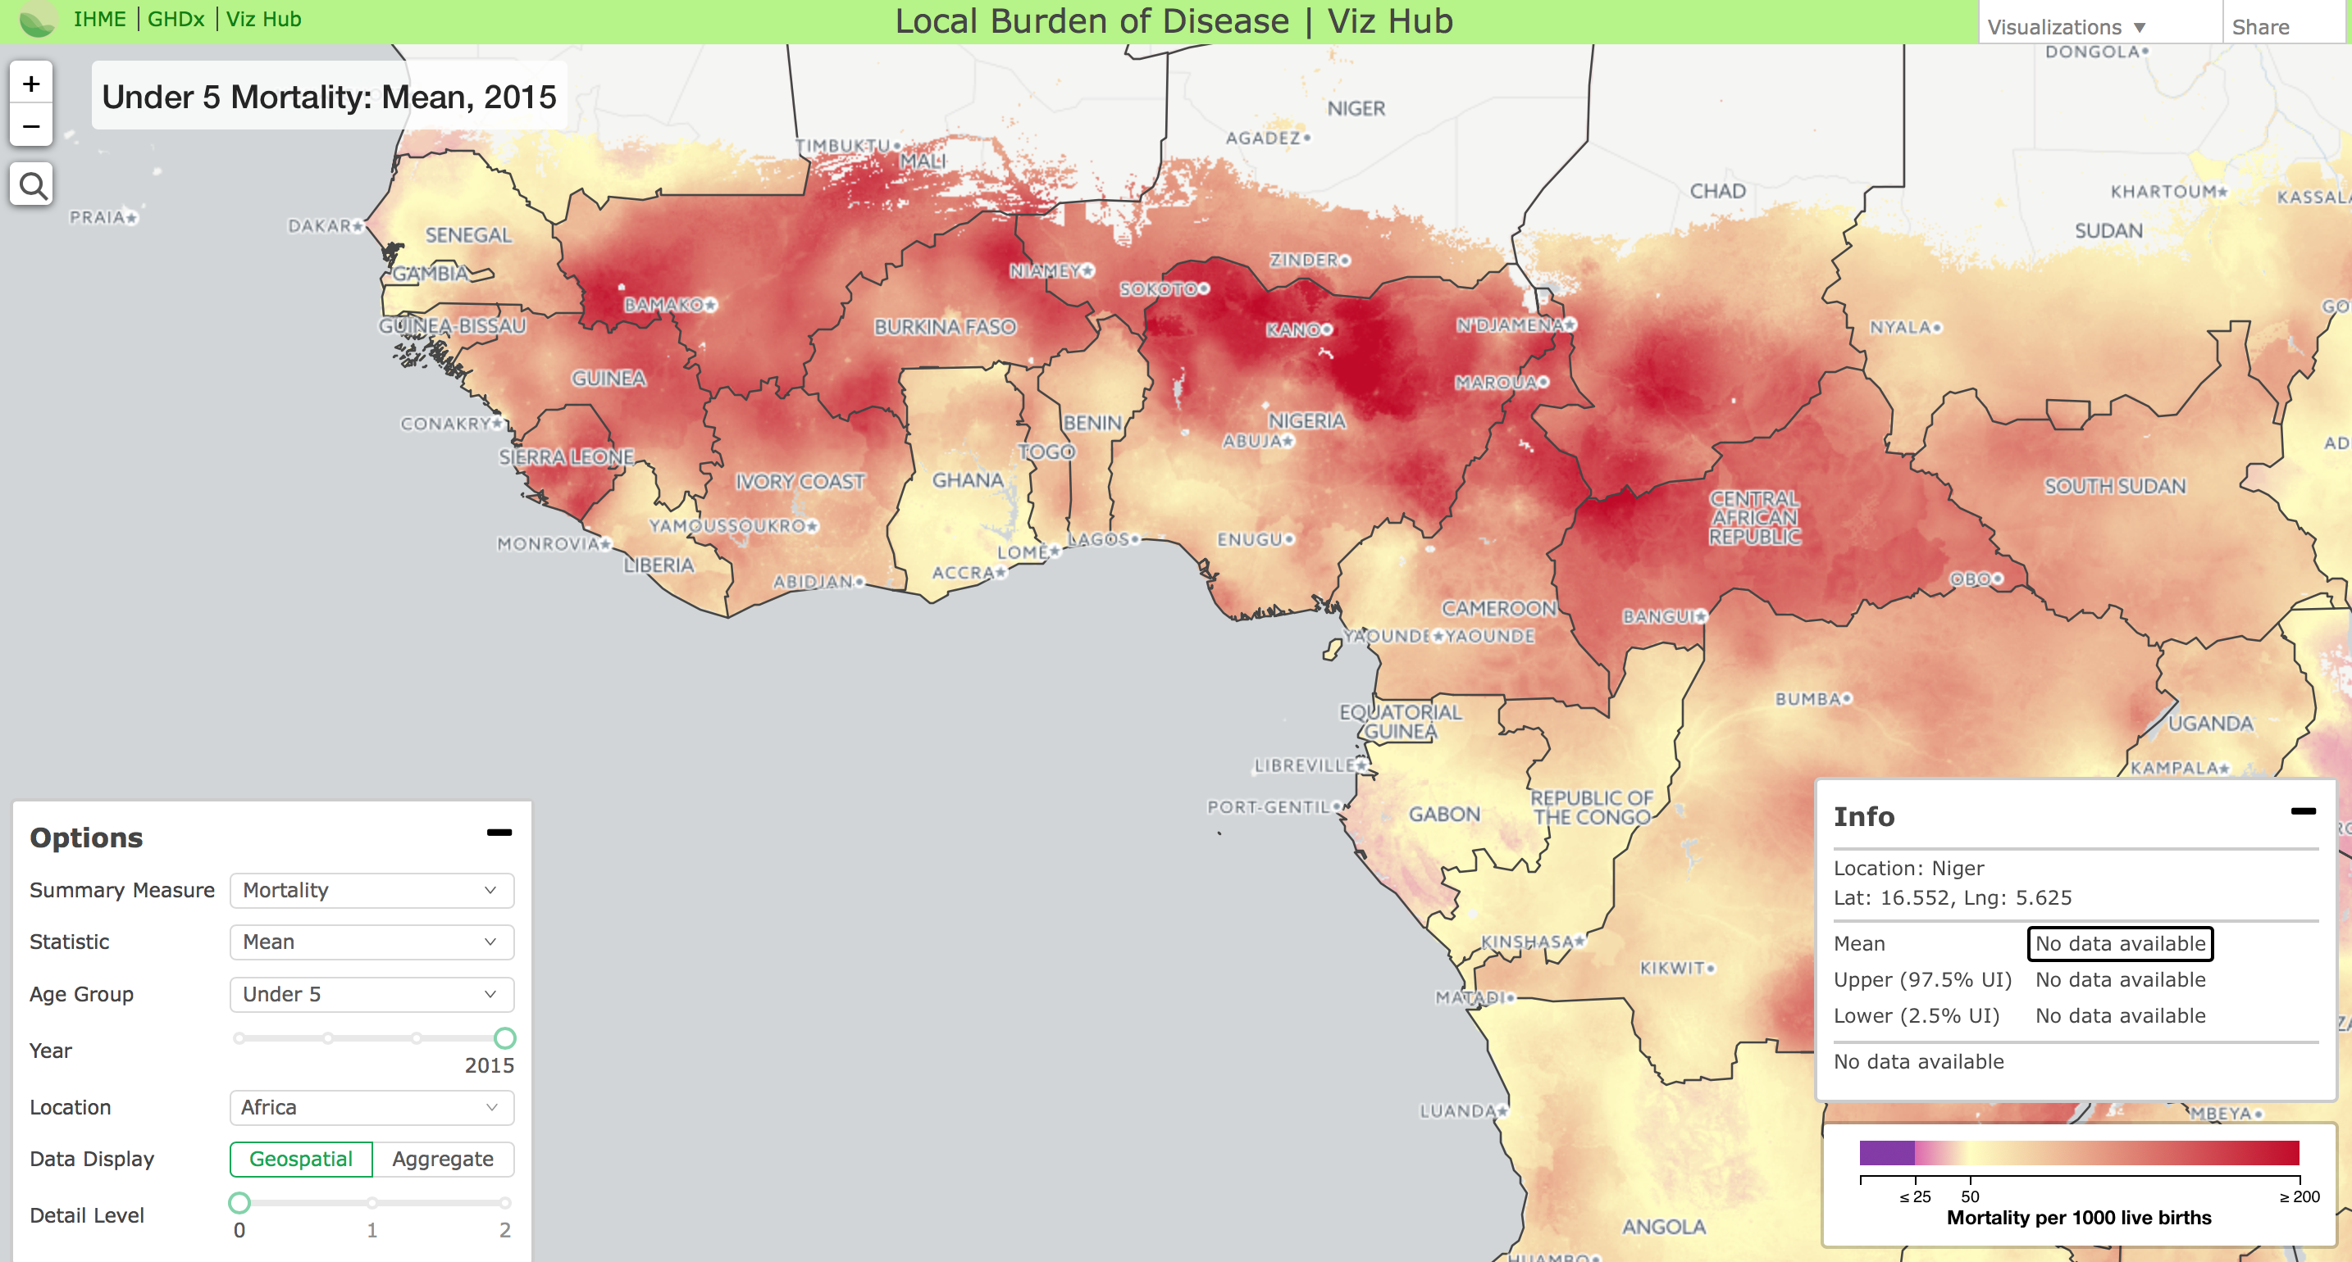
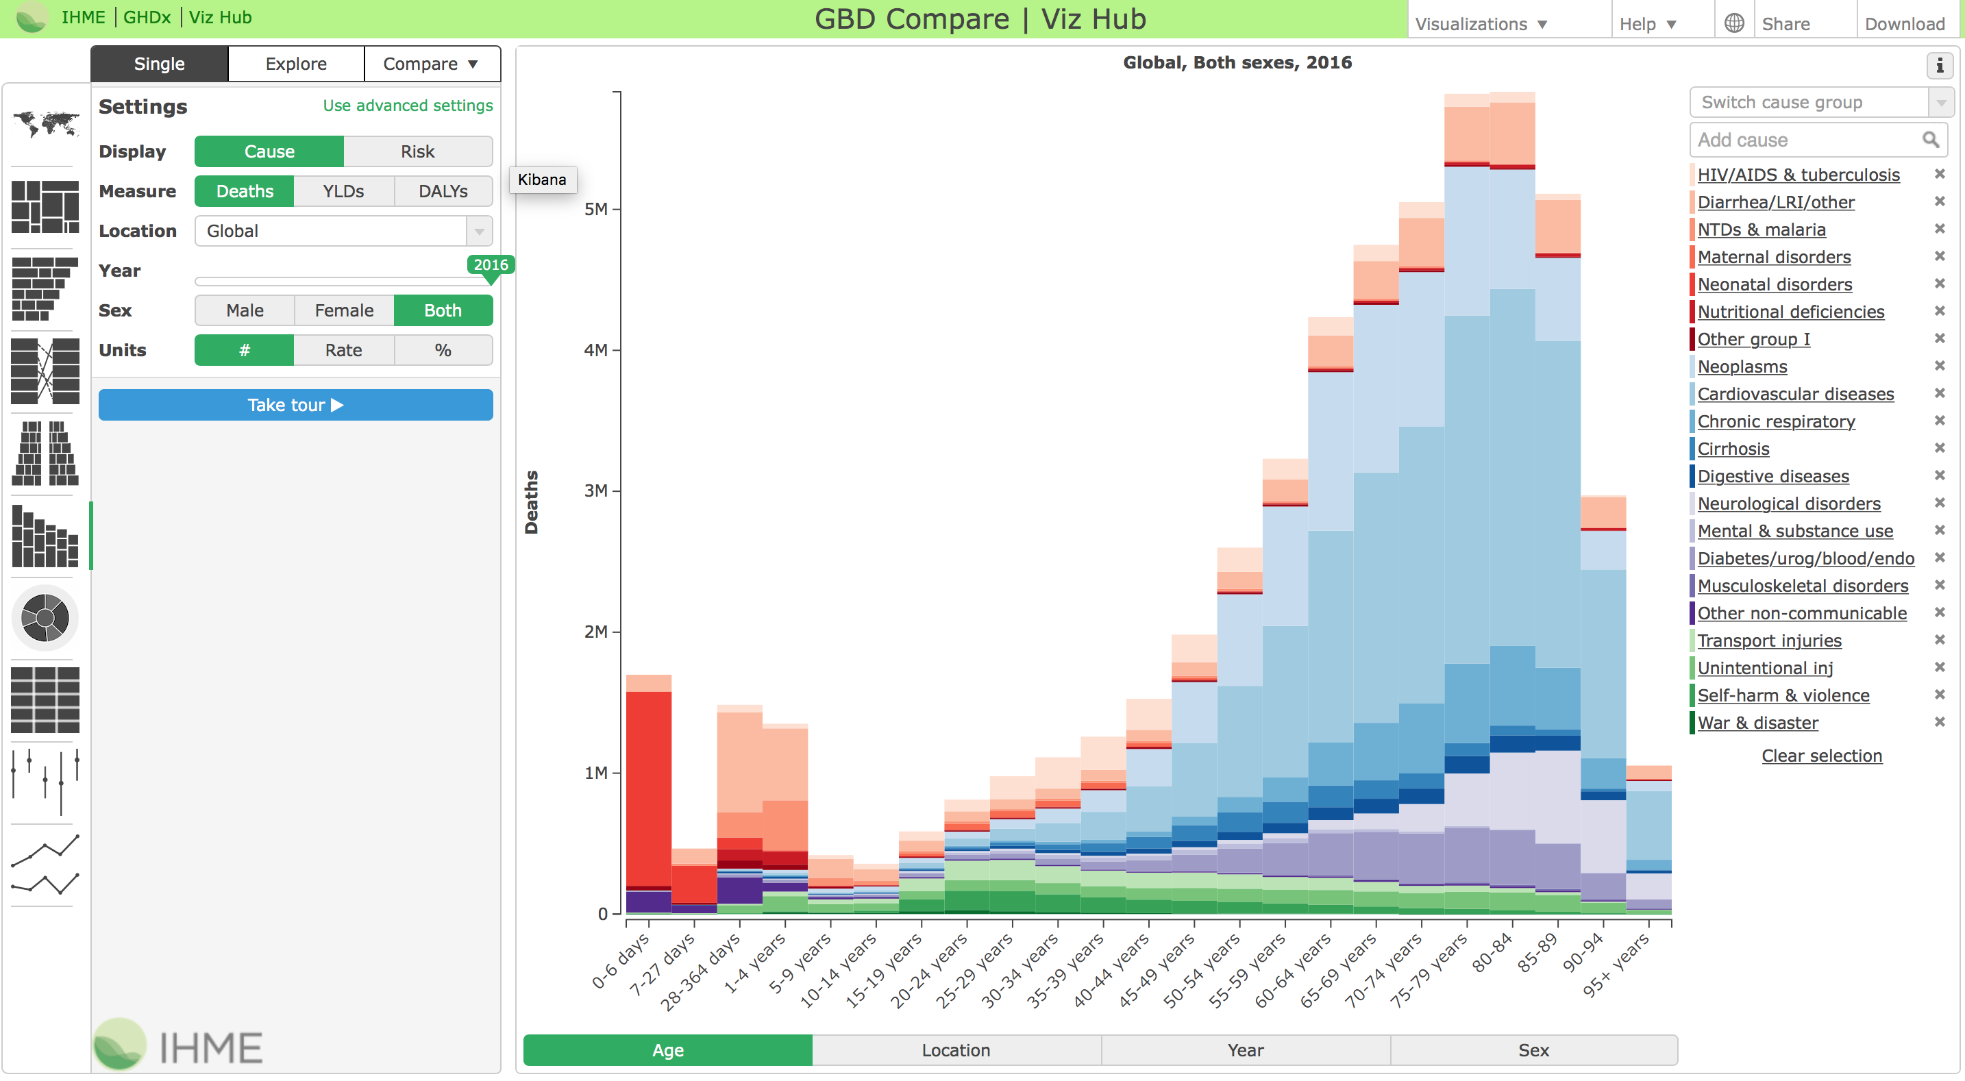
Software
Primary Modeling
R-Studio, Shiny, Jupyter, Numpy, Pandas, Libgeos
Univa Grid Engine
Build & Pipelines
Luigi, Jenkins
Database
Percona, MariaDB
Web
HTML & home-grown viz frameworks

Slide 21
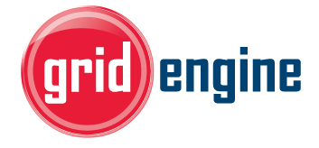



Current Architecture
Production Cluster
21,000 Cores:
Development Cluster
4,000 Cores:
End User
Web App
CL
Shared Storage
160 Gb/s
160 Gb/s

Slide 22
The Path to NavOps
Leverage existing UGE expertise and commitment.
Researchers have intimate knowledge of UGE scheduler.
Maximize use of our environment.
Ability to re-allocate resource at peak times is mission-critical.
Simplify resource management.
There were too many tools being used.
Notes:
Day-to-day support

Slide 23
Univa and IHME

Slide 24
The Solution for IHME – Mixed Workloads
Virtual Multi-tenancy
Mixed Workloads
Manage Cloud Resources
Application Workflows
Run Mesos Frameworks
Share clusters across teams and applications
Run containerized and non-containerized workloads on shared resources
Prioritize workloads to efficiently use on-premises and cloud resources
Sequence workflows to address job dependencies
Run frameworks seamlessly on a Kubernetes cluster

Slide 25
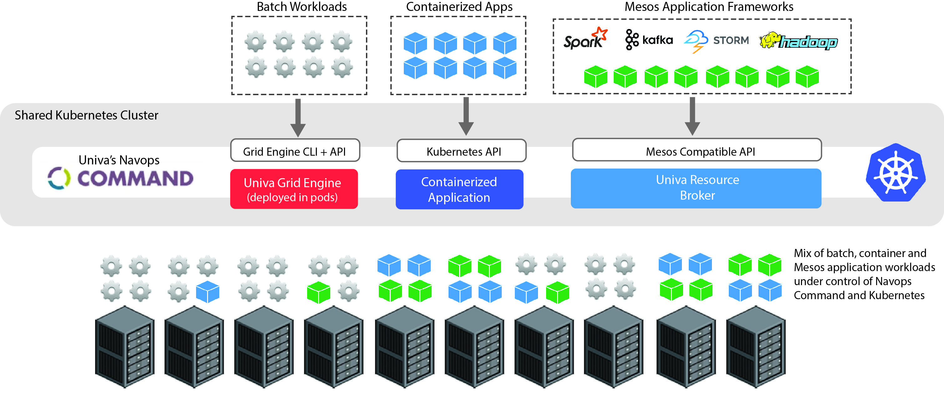
Mixed Workloads on Kubernetes

Slide 26
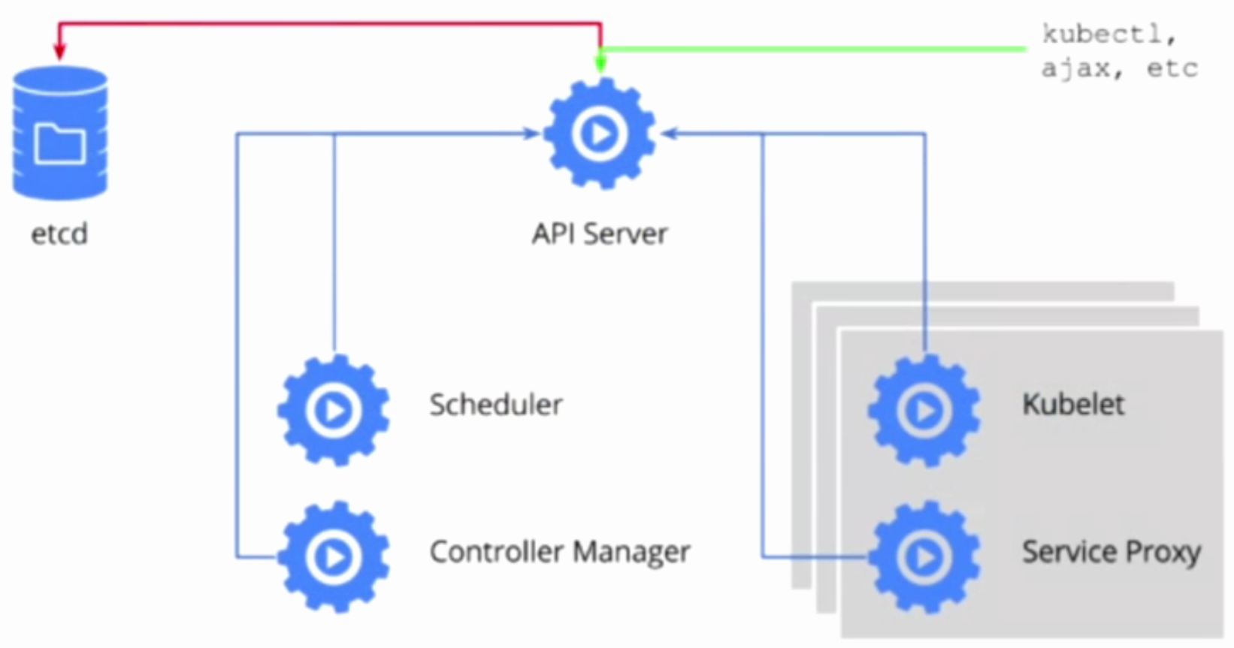
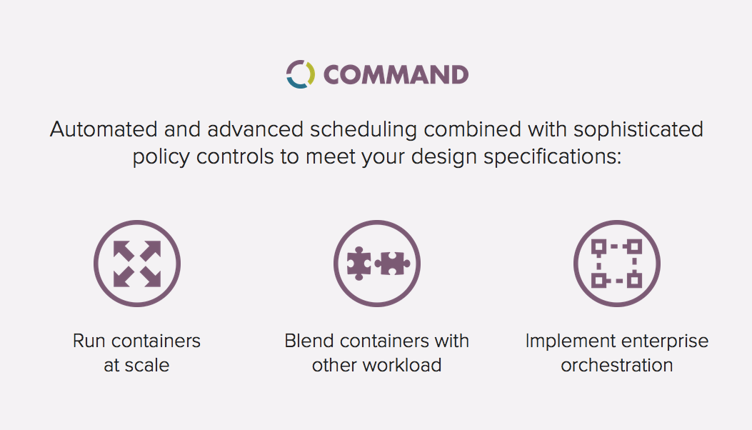
Navops Command K8s Integration

Slide 27
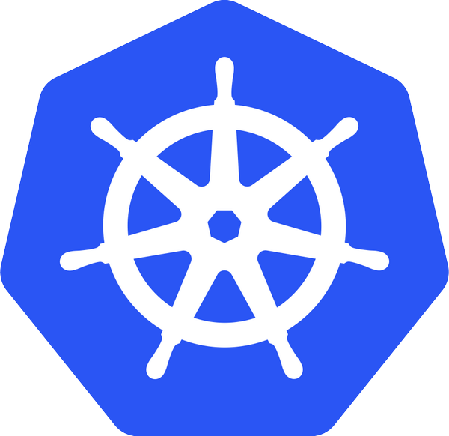
Navops Command Architecture
End User
Admin
Navops Command Pod
Kubectl
Web UI
CLI
REST API
Bridge Container
App Management Container
Kubernetes
API Server
Backend
REST Svc API
Kubernetes
Objects
Master Process
Etcd Container
Scheduler Thread
etcd
App Launcher
Assign pods to nodes

Slide 28

Advanced Policies for Kubernetes
Workload Isolation
Workflow Management
Workload Affiliation
Runtime Quotas
Access Restrictions
Owner
Project
Application Profile
Pod Dependencies
Enterprise Workload Policies
Workload Priority
Node Selection
Proportional
Shares
Interleaving
by Application Profile
by Resource
Ranking
by Application Profile
by Resource
Pod Placement
Maximize Utilization
Pack
Spread
Mix

Slide 29
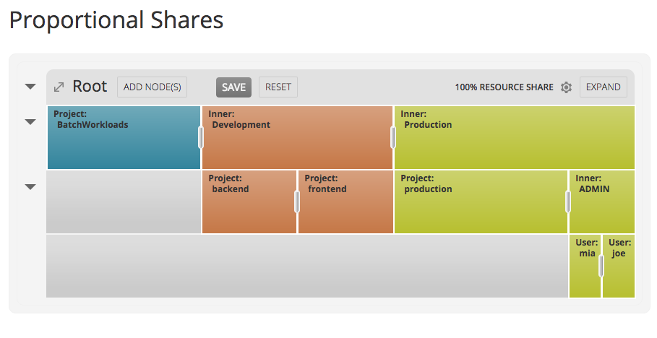
Navops Proportional Sharing

Slide 30
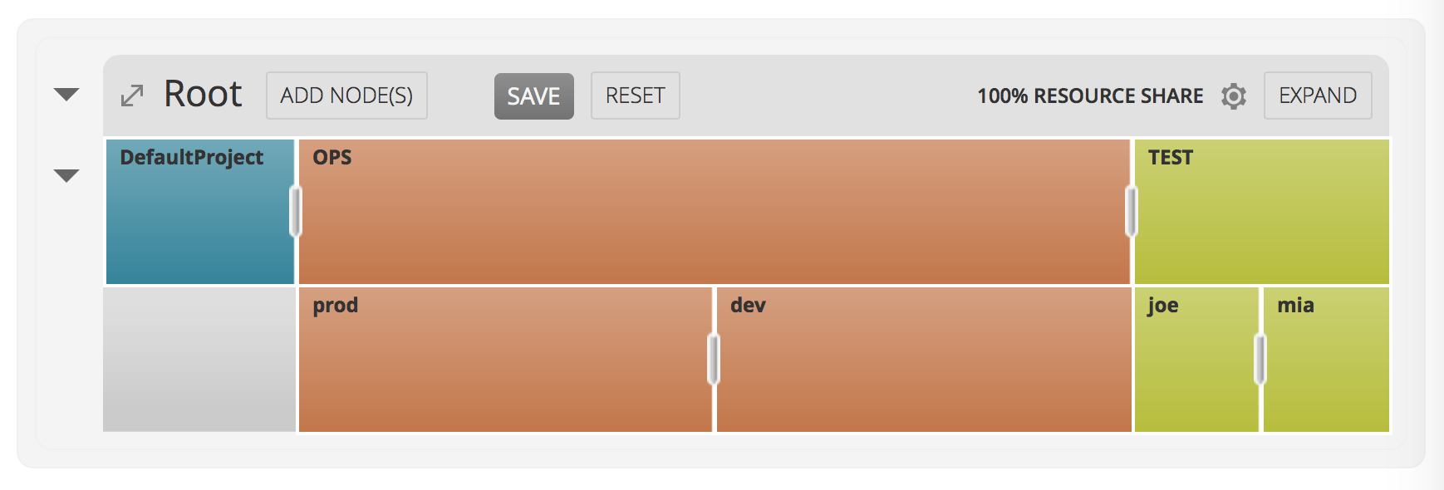



Bringing new capabilities to Kubernetes
Capability
Description
Advanced Multi-Tenancy
Teams and projects get equitable share of K8s cluster
Automatic implementation of desired resource partitioning
Use overflow capacity while guaranteeing critical needs
Run-Time Quotas
Effectively limit workloads from growing out of bounds
Put limits on various resource consumables
Automate limit management flexible rule sets
Balanced Replicas
Maintain replica ratios across service components
Automatic implementation of desired replica ratios
Dynamic adjustments as services get scaled
Best Fit
Optimize utilization &performance via best-fit placements
Match workloads needs against actual availability on nodes
Automatic best-fit or various pack/spread options
Automatic Eviction
Automatic adjustment of service scale on behalf of policies
Evict replicas of services violating policies that control multi-tenancy, access restrictions, quotas or replication balance
Mixed Workloads
Run non-containerized workloads on top of K8s
Avoid silos plus simplify management and app integration
Increase utilization and facilitate smooth migration to K8s
Workflows
Support workflows with interdependent steps
Automate orchestrated execution and avoid errors

Slide 31




Mixed Workloads with Navops
Using Navops Command with Grid Engine, customers can support mixed-workloads on a shared Kubernetes cluster
Traditional Batch / Analytic Workloads
Containerized Applications
Various non-container HPC analytic workloads – batch, interactive, parallel, parametric etc.
Docker containerized applications – containers, services, application stacks
Kubernetes Cluster
Univa’s Navops
Containerized Application
Containerized Application
execd
execd
execd
execd
execd
execd
Grid Engine deployed in pods as a Kubernetes service
Mix of application workloads with dynamic resource sharing under control of Navops Command and Kubernetes
Shared IHME On-Premises Kubernetes Cluster

Slide 32

Navops Command Delivers
Before: <20% Utilization
After: >50% Utilization
Cluster A
MicroServices
Cluster B
MicroServices
MicroServices
& Batch Workloads
Cluster C
Batch
Virtual multi-tenancy | Share clusters across teams and applications
Mixed Workloads | Allow batch and microservice applications to run on shared resources
Management of Resource Scarcity | Allow application loads to take advantage of non peak times for other workloads

Slide 33
Benefits to IHME
Simplified administration and improved efficiencies by supporting multiple workloads across a single, shared environment
Increased flexibility by providing an easy migration path for applications that cannot be readily containerized
Notes:
Day-to-day support

Slide 34
Thank You!
Questions? Ask now or ...
Find us at booth #56
Visit https://navops.io and https://univa.com
Contact us at jsmith@univa.com or tgrand@uw.edu

